Slide 1


Geo-Sense Parking System
Wujun Song - S314921 Augustine Thorbjornsen - S290428
Xuemin Guo – S321320 Qijing Huang - S322704

Slide 2

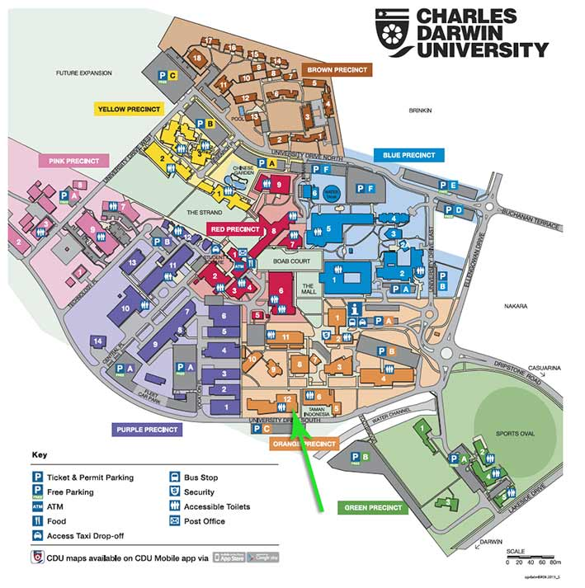

Bob’s problem
Bob is a new student at CDU.
But he has to go to class.
Bob wants to find the closest parking spot to purple 12.
But Bob doesn’t know how…
Bob then goes and finds the CDU campus map.
But Bob gets a headache and gets lost.
Will Bob be late for class?
To be continued…

Slide 3

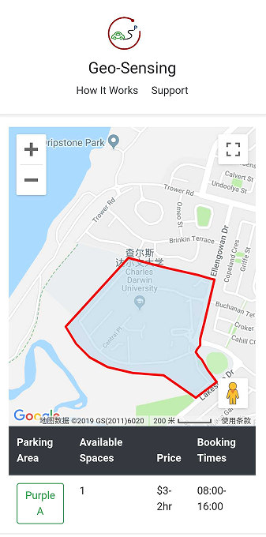

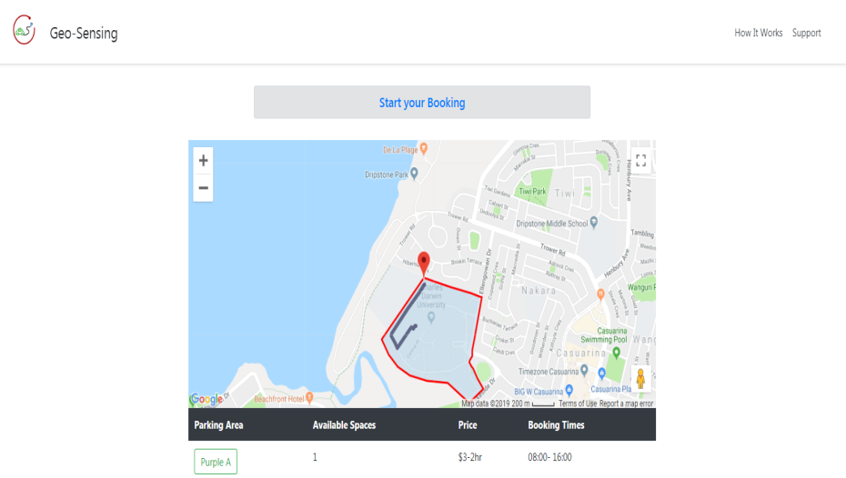
What is Geo-Sensing?
Geo Fence around CDU campus
Location based with routing directions
Automated fastest route to available parking spot
Mobile and PC friendly

Slide 4
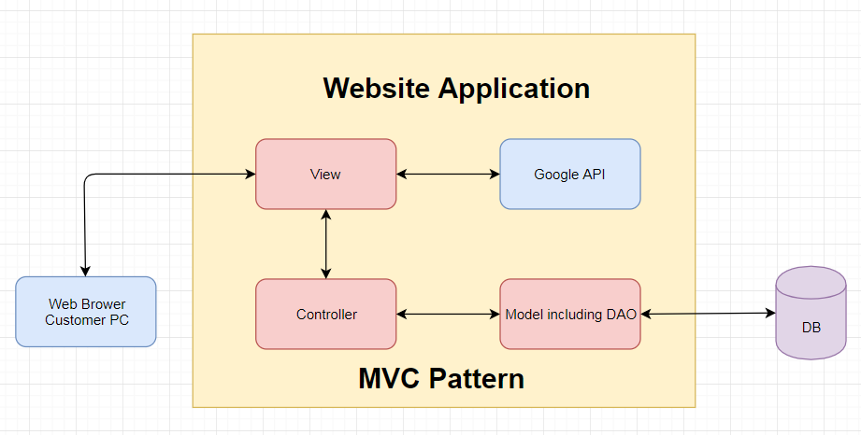





System Architecture
System Environment :
IDE
- Myeclipse 10
Database
- Oracle 11g on Linux
Apache Sever
- Tomcat 7.0
- JDK 1.6
VMware Workstation 8.0

Slide 5
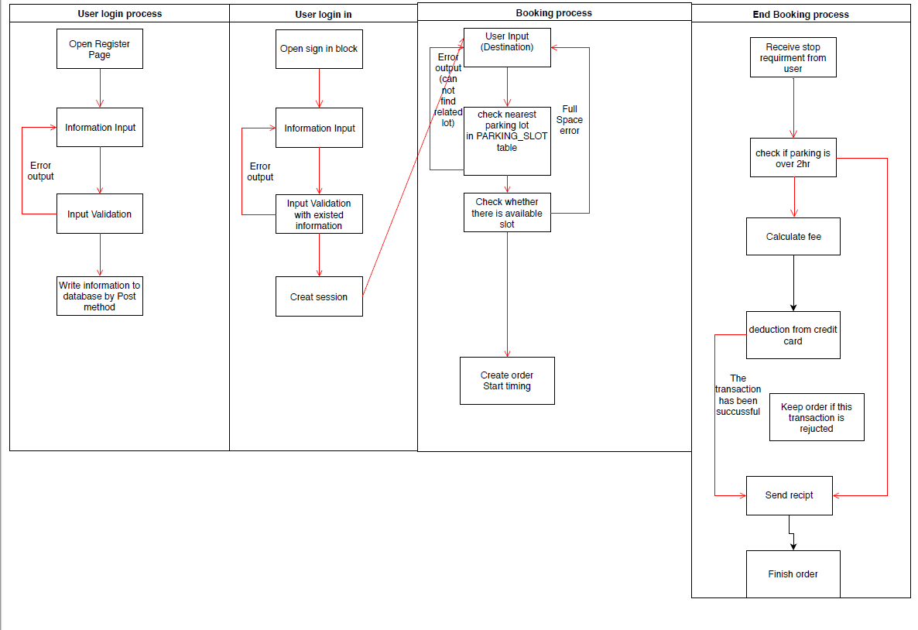
Process Modeling

Slide 6





Client Requirement
Functional Requirement
Non-Functional Requirement
Parking time 8:00AM-4:00PM
Mobile friendly
Google Maps API
System needs to prevent SQL injection
No Cross site scripting attacks or forgery
Multilayered Defense

Slide 7
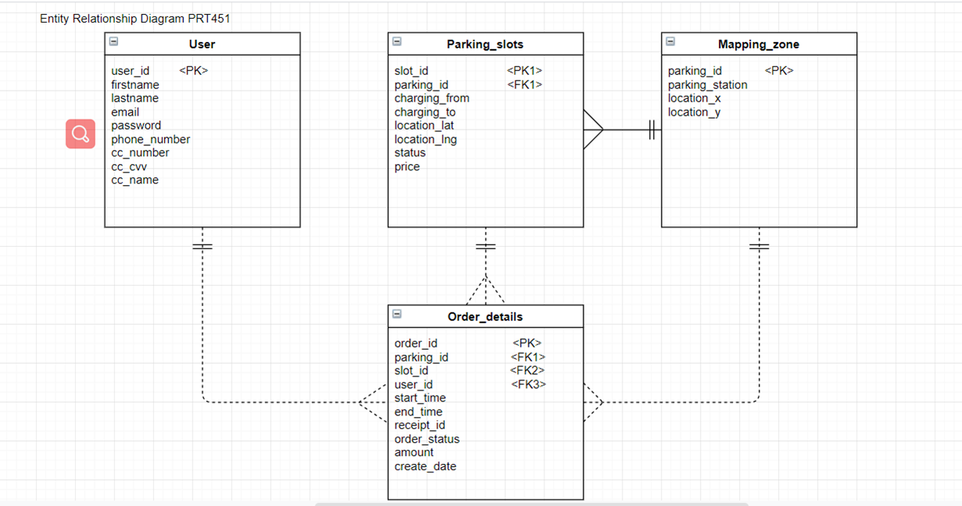
Database Design

Slide 8
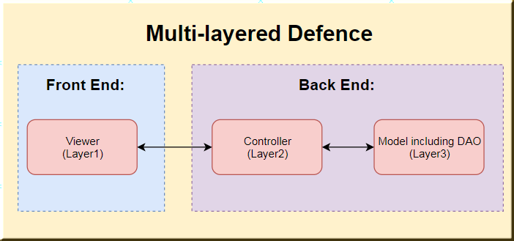
High Level Security
01
02
03
Frond End Validation
Back end Validation
Data Access Layer - (DAO)
How to defend
Multiple layer defense to SQL injection and X-Site Script

Slide 9
Testing
Acceptable Software
Integration Test
4
2
1
3
Unit Test
Security Test

Slide 10
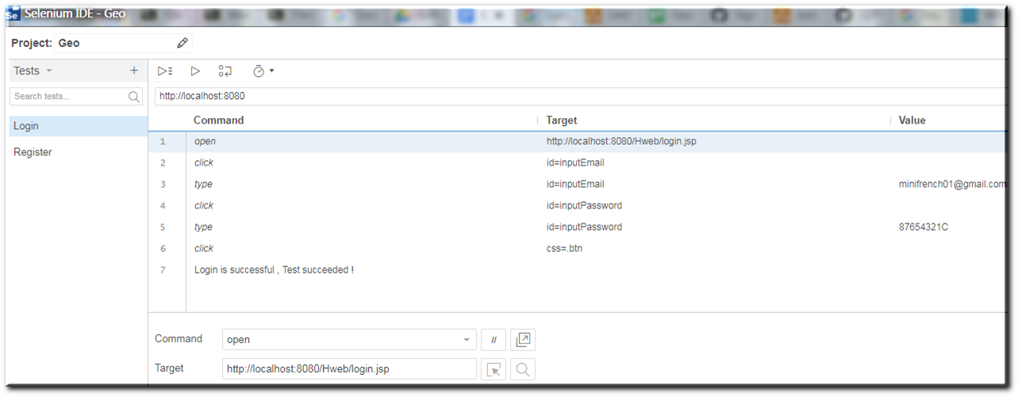


Testing Tools
Selenium IDE
SQLMAP

Slide 11

What happened to Bob?
Thanks to Geo-sensing Parking
Bob becomes a successful student.
And never was late to class again.

Slide 12


Thank you!

